Slide 1

dbms project
Vishnu Manoj - PES1201700801
Ritwik Sinha - pes1201700085
Abihishek - pes1201700

Slide 2

Hospital data base management system
dbms project
A hospital a lot of data that is crucial and can not be lost. To keep all the data secure and in order, hospitals have started using data base management systems to store their data. This way all the data of the hospital is organized and the information can be retrieved easily. This saves time in huge hospitals where there is a lot of data and its hard to find a particular record. It also helps doctors in accessing the information of previous patients which can be used to treat new patients.

Slide 3
Entities
Hospital data base management system
Admin
Patient
Doctor
Nurse
Assistant

Slide 4
Admin entity
Hospital data base management system
The admin has access to all the entities of the hospital database management system.
The admin can update the data in the database in case of any changes like, when someone gets a hike in their salary.
All the details of all the doctors, patients, nurses and assistants can be viewed by the admin.
The details of the Admin such as Name, Age, Date of Joining, Salary, are stored.

Slide 5
patient entity
Hospital data base management system
The patient entity stores all the vital information of all the patients.
It can be accessed by the Doctors and the Nurses while treating the patient.
Important details like Name, Age and the diseases of the patient is stored.
The details of the patient can be accessed by the Doctors, Assistants and Nurses in charge of the patient.

Slide 6
doctor entity
Hospital data base management system
The doctor entity stores all the information of all the doctors in the hospital.
The information in this entity can be accessed by the admins of the hospital.
All the details of all the patients like their name, age and the diseases they have are shared with the doctor.
The details of the Doctor such as Name, Age, Date of Joining, Salary, Department, Assistants and Nurses who work under the doctor are stored.

Slide 7
nurse entity
Hospital data base management system
The nurse entity stores all the information of all the nurses in the hospital.
It can be accessed by the Doctors and the Assistants who supervise the nurse.
The details of the patients are shared with the nurses so they can treat the patients well.
The details of the Nurse such as Name, Age, Date of Joining, Salary, Departments, Assistants and the Doctors under whom they work are stored.

Slide 8
assistant entity
Hospital data base management system
The assistant entity stores all the information of all the assistants in the hospital.
It can be accessed by the Doctors whom the assistants work under.
The details of the patients are shared with the assistants so that they can guide the nurses with the doctors instructions on how to treat the patient.
The details of the Assistant such as Name, Age, Date of Joining, Salary, Departments and the Doctors under whom they work are stored.

Slide 9
Relationships between the entities
Hospital data base management system
Controls
Helps
Treats
Instructs
Guides

Slide 10
Comparison with real world example
Hospital data base management system
Hospital Management System by Tirupati International is a real life example of Hospital Data Base Management System.
This data base system can count the number of wards in the hospital and check if the wards are occupied at the moment, it can also give the real time state of the medicinal supplies in the hospital which can not be done in the database management system we have made. The data base management system we have made can check the status of all the employees in the hospital along with the patients as well as track the doctor, nurse and other staff assigned to each patient.

Slide 11
Problems faced while creating the database
Hospital data base management system
Linking all the entities: Initially when we used queries the results were repeated when the entities were not linked. Later on we linked them using Reference command and creating a separate table for each relationship.
Creating statistics: We faced difficulty in retrieving the appropriate information for creating the graphs for the required statistics. We solved this problem by checking the values properly and referring to the correct tables to retrieve the information.

Slide 12
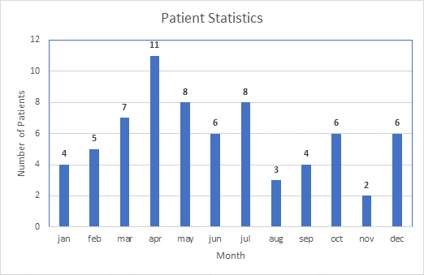
Statistics
Hospital data base management system

Slide 13
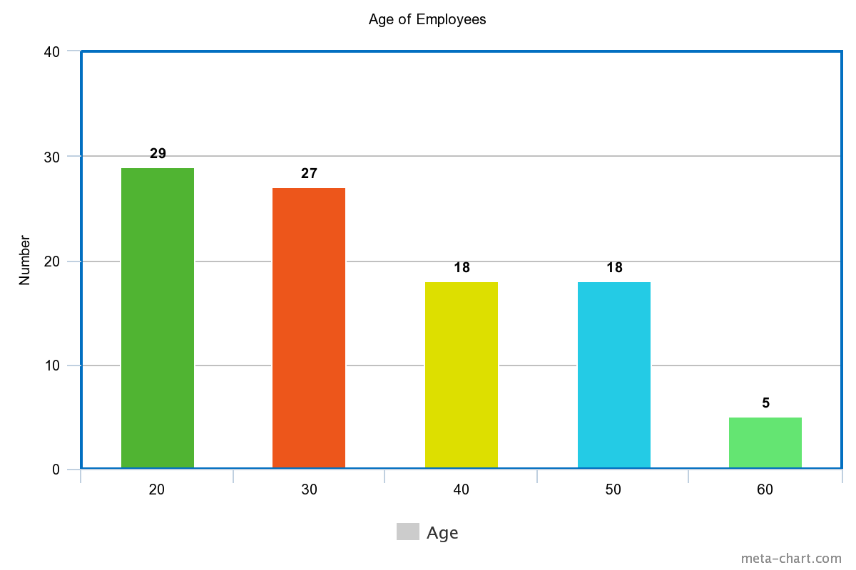
Statistics
Hospital data base management system

Slide 14
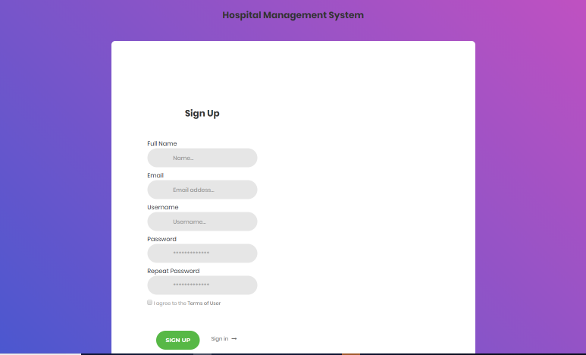
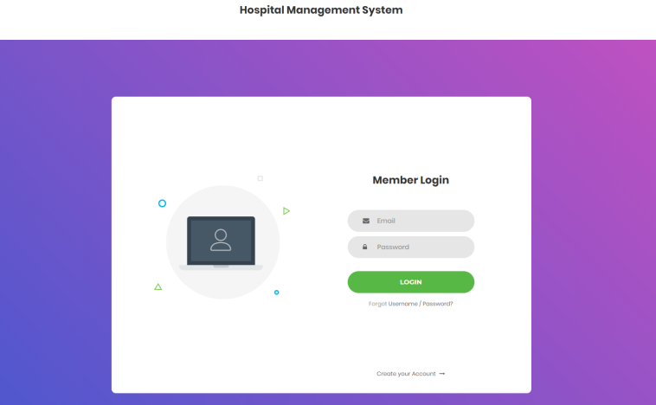
Screenshots of the ui

Slide 15

thank you

